Slide 1
ORION SYSTEMS & DESIGN LTD
Company Profile
By Jean Claude NKIZABAGABO

Slide 2
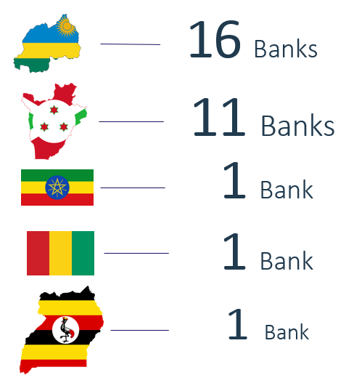
Who We Are ?
10 + Experience in Banking Industry. Serving East African Banks

Slide 3
Our Solutions
Instant Payment Gateway: Middleware between IPS and Core Banking System and e-channels
Internet banking: Web-based platform for customers to perform real time transactions
Mobile Banking (USSD, Android & iOS): To provide access to banking services on mobile phone
Agency Banking - Extends branch services to customers through bank agents
Automated Micro-Lending
Automated Salary Advance
Clearing and Cheque Truncation solution - enables exchange of interbank transactions through central clearing house

Slide 4
Our Solutions Cont’d
ATM Bridge system – ATM Middleware using ISO message standards
E-Government Service Digitization
E-statement - This is an automated generation of customer account statements
Email & SMS notification - To send customized SMS and email notification to clients in bulk
Core Banking System Consultancy – Integrations, Procurement & Implementation
Insurance management system – Core System for insurance companies
Customized Solutions – Systems developed according to customers’ needs

Slide 5
Our IPS (RNDPS/eKash) Clients
MTN - Rwanda
Cogebanque
Zigama CSS
Access Bank
Umwalimu SACCO
NCBA - Rwanda
COPEDU

Slide 6






Our Clients
Muganga Sacco
Internet Banking
Fin Bank - Burundi
Internet, Mobile and Agency
I&M Bank
Internet Banking
Revamp
I&M Bank
Mobile Banking
Revamp
Bank of Africa
Mobile Banking
Urwego Bank
Internet Banking

Slide 7
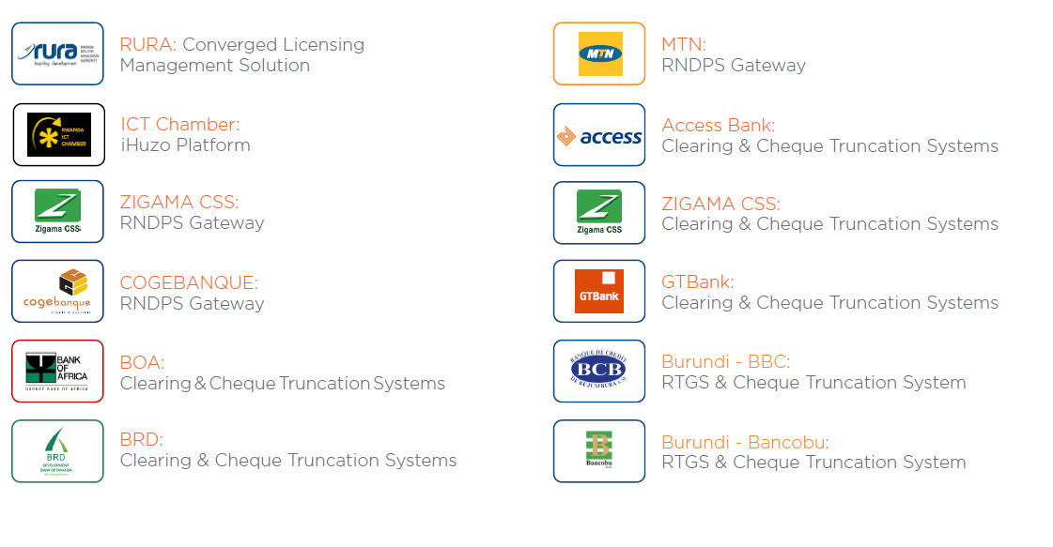
Our Clients Cont’d

Slide 8
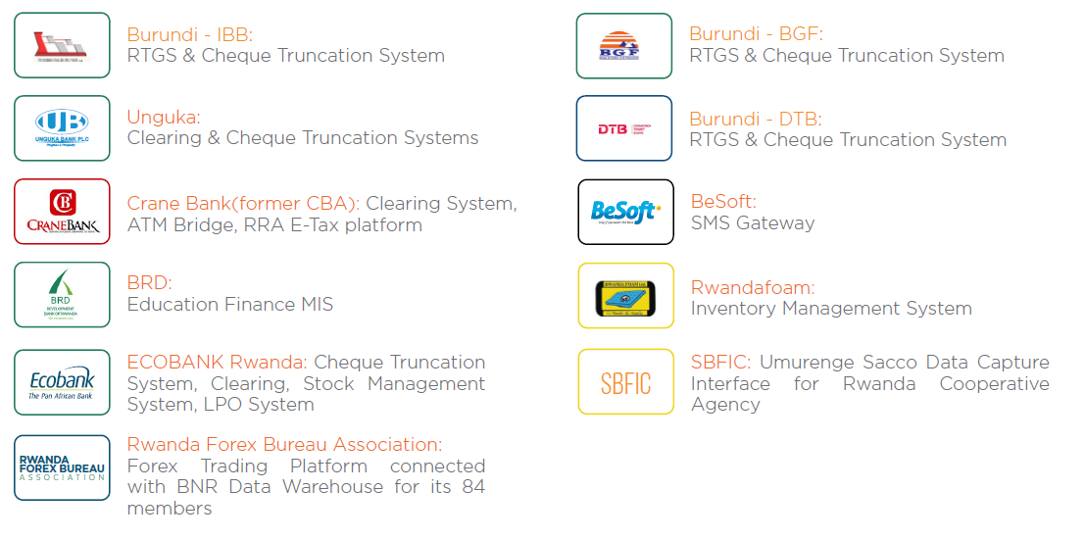
Our Clients Cont’d

Slide 9
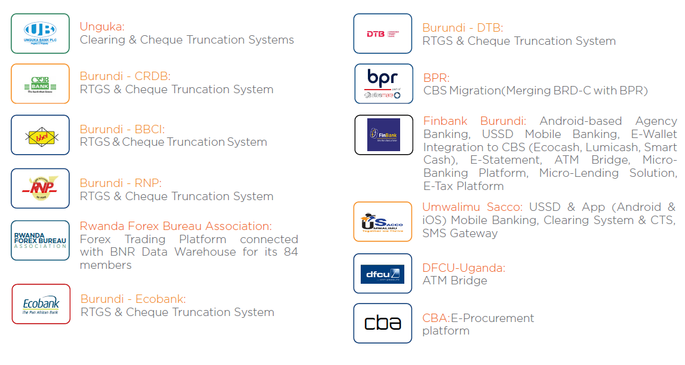
Our Clients Cont’d

Slide 10
Our vision for Mojaloop
Become Mojaloop implementation partner
Handle Mojaloop System Integrations
Development of Mojaloop Demos/Interfaces (Focus: P2P, Merchant, Request to Pay, Cash In & Cash out)
Use Mojaloop for our existing shared digital channels (Internet & Mobile Banking, Agency Banking, etc.)

Slide 11
Where are we with Mojaloop?
Attended SI Acceletor Program
Deployment of Miniloop on our VPS
Deployment of Payment Manager on our VPS
Development of PM Core Connector
Development of Mojaloop Demo V1: Web portal to test:
Account Registration on ALS (Account Lookup Service)
Account Lookup
Quoting Service
P2P Transfer

